Slide 1
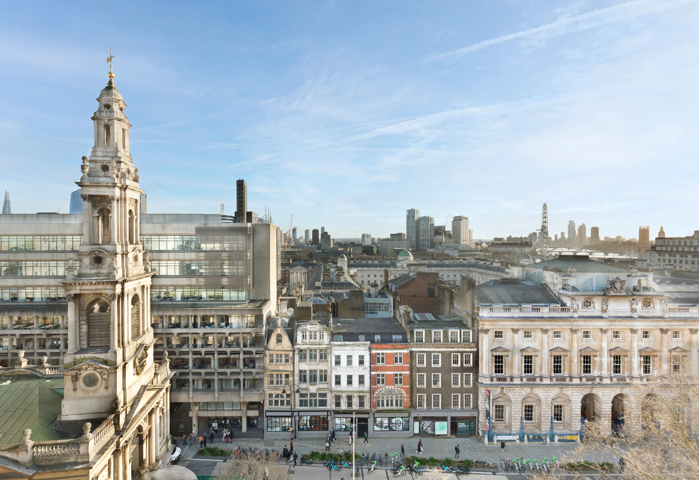

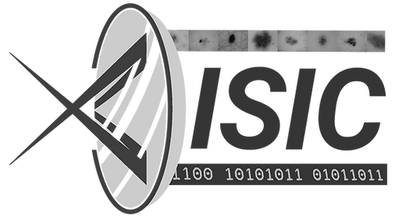









MultiVit: A Vision Transformer with Adaptive Cross-Image and Cross-Resolution Attention
Benjamin A. K. Murray¹, Wei R. Tan², Liane S. Canas¹, Catherine H. Smith², Satveer K. Mahil², Sebastien Ourselin¹, Marc Modat¹
1. School of Biomedical Engineering & Imaging Sciences, King’s College London
2. St John’s Institute of Dermatology, Guy’s and St Thomas’ NHS Foundation Trust and King’s College London

Slide 2
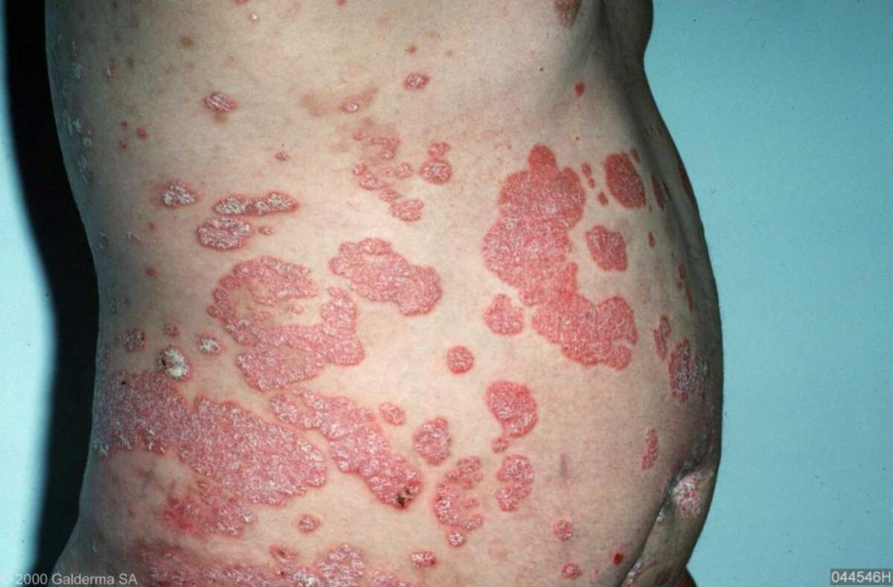
Introducing Psoriasis
Properties
Genetic
Environmental
Immune system
Inflammation process
Chronic
Episodic
Incurable (treatable)
Diffuse
Heterogeneous
Pcds.org.uk/patient-info-leaflets/psoriasis. Used under fair use for educational purposes

Slide 3
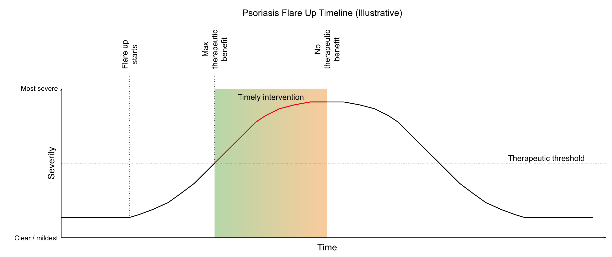
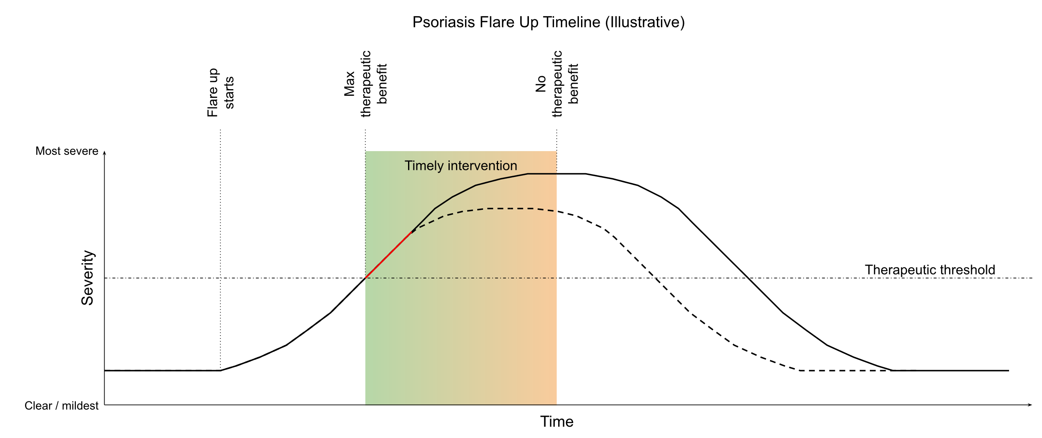
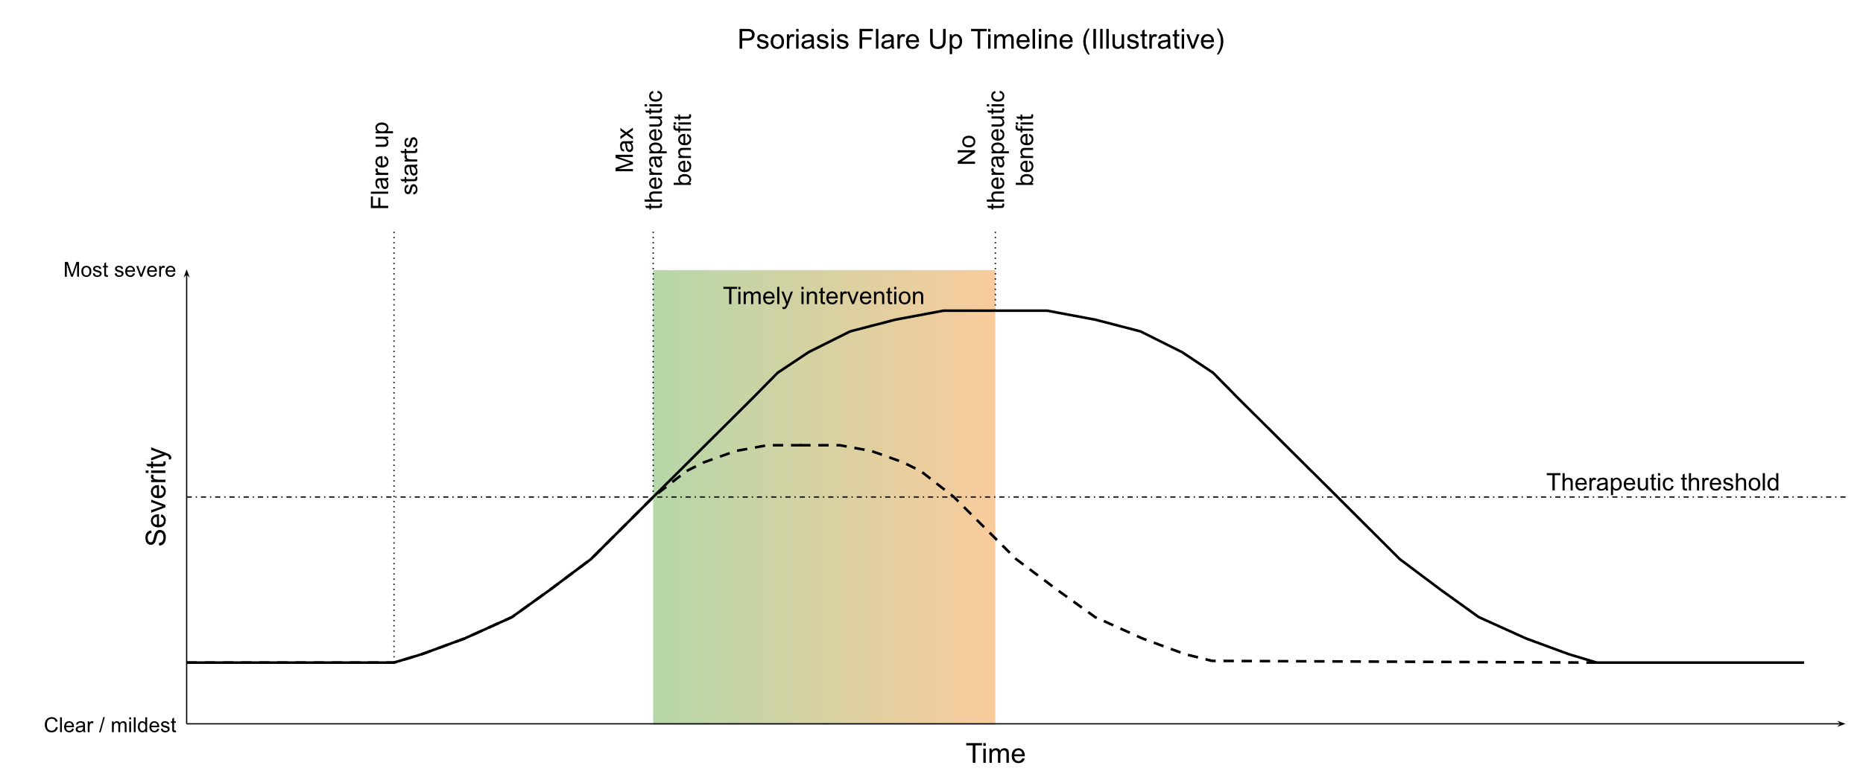



Treating Psoriasis – timely intervention is key

Slide 4
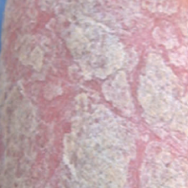
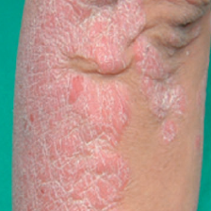
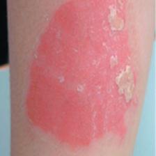
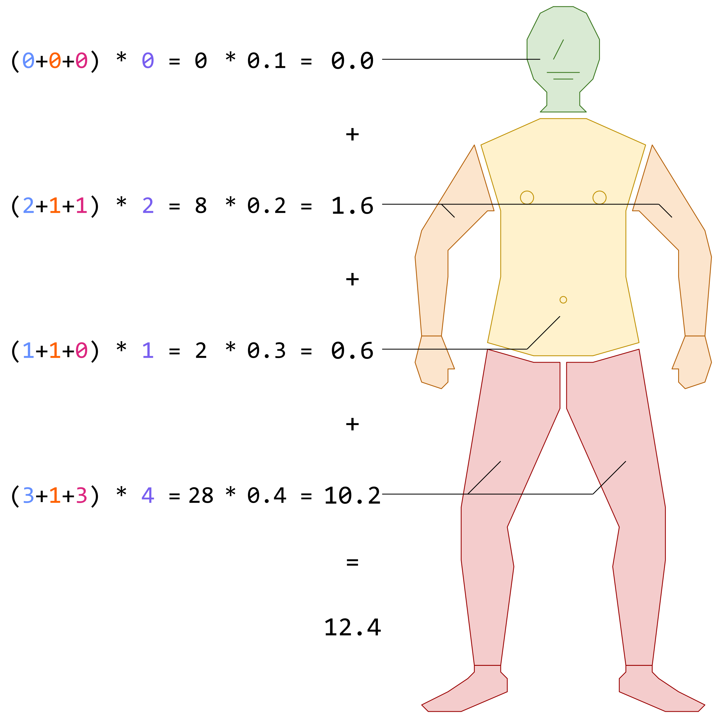
Measuring Psoriasis
Scaling
Induration
Erythema
PASI
Per-body region
Grade three aspects from 0 – 4
Multiply by area score from 0 – 6
(4+4+4) * 6 = 72
Total score
Weighted sum of body regions
10+ is severe
Physician's Global Assessment
Whole body assessment of severity
0 – 5
4+ is severe
Lin et al., “Quality of life in patients with psoriasis in Northern Taiwan”, Chang Gung medical journal 03/2011. Adapted under fair use for educational purposes

Slide 5
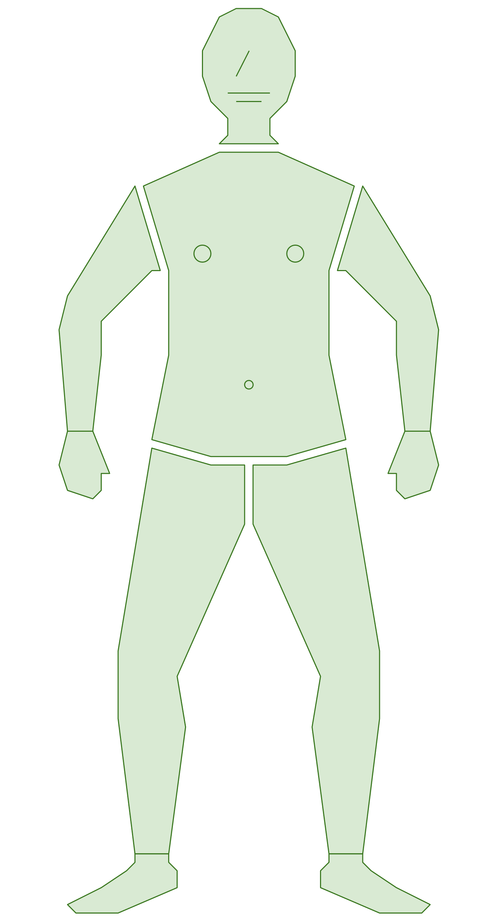
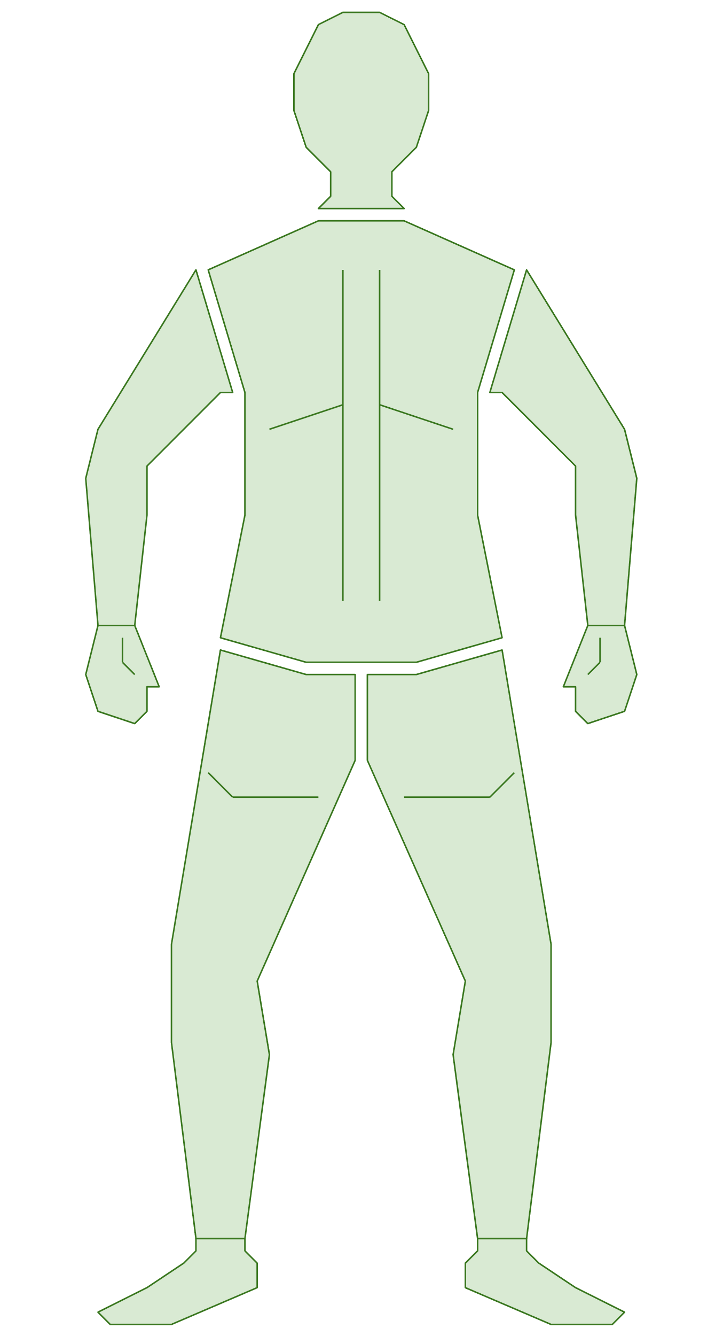
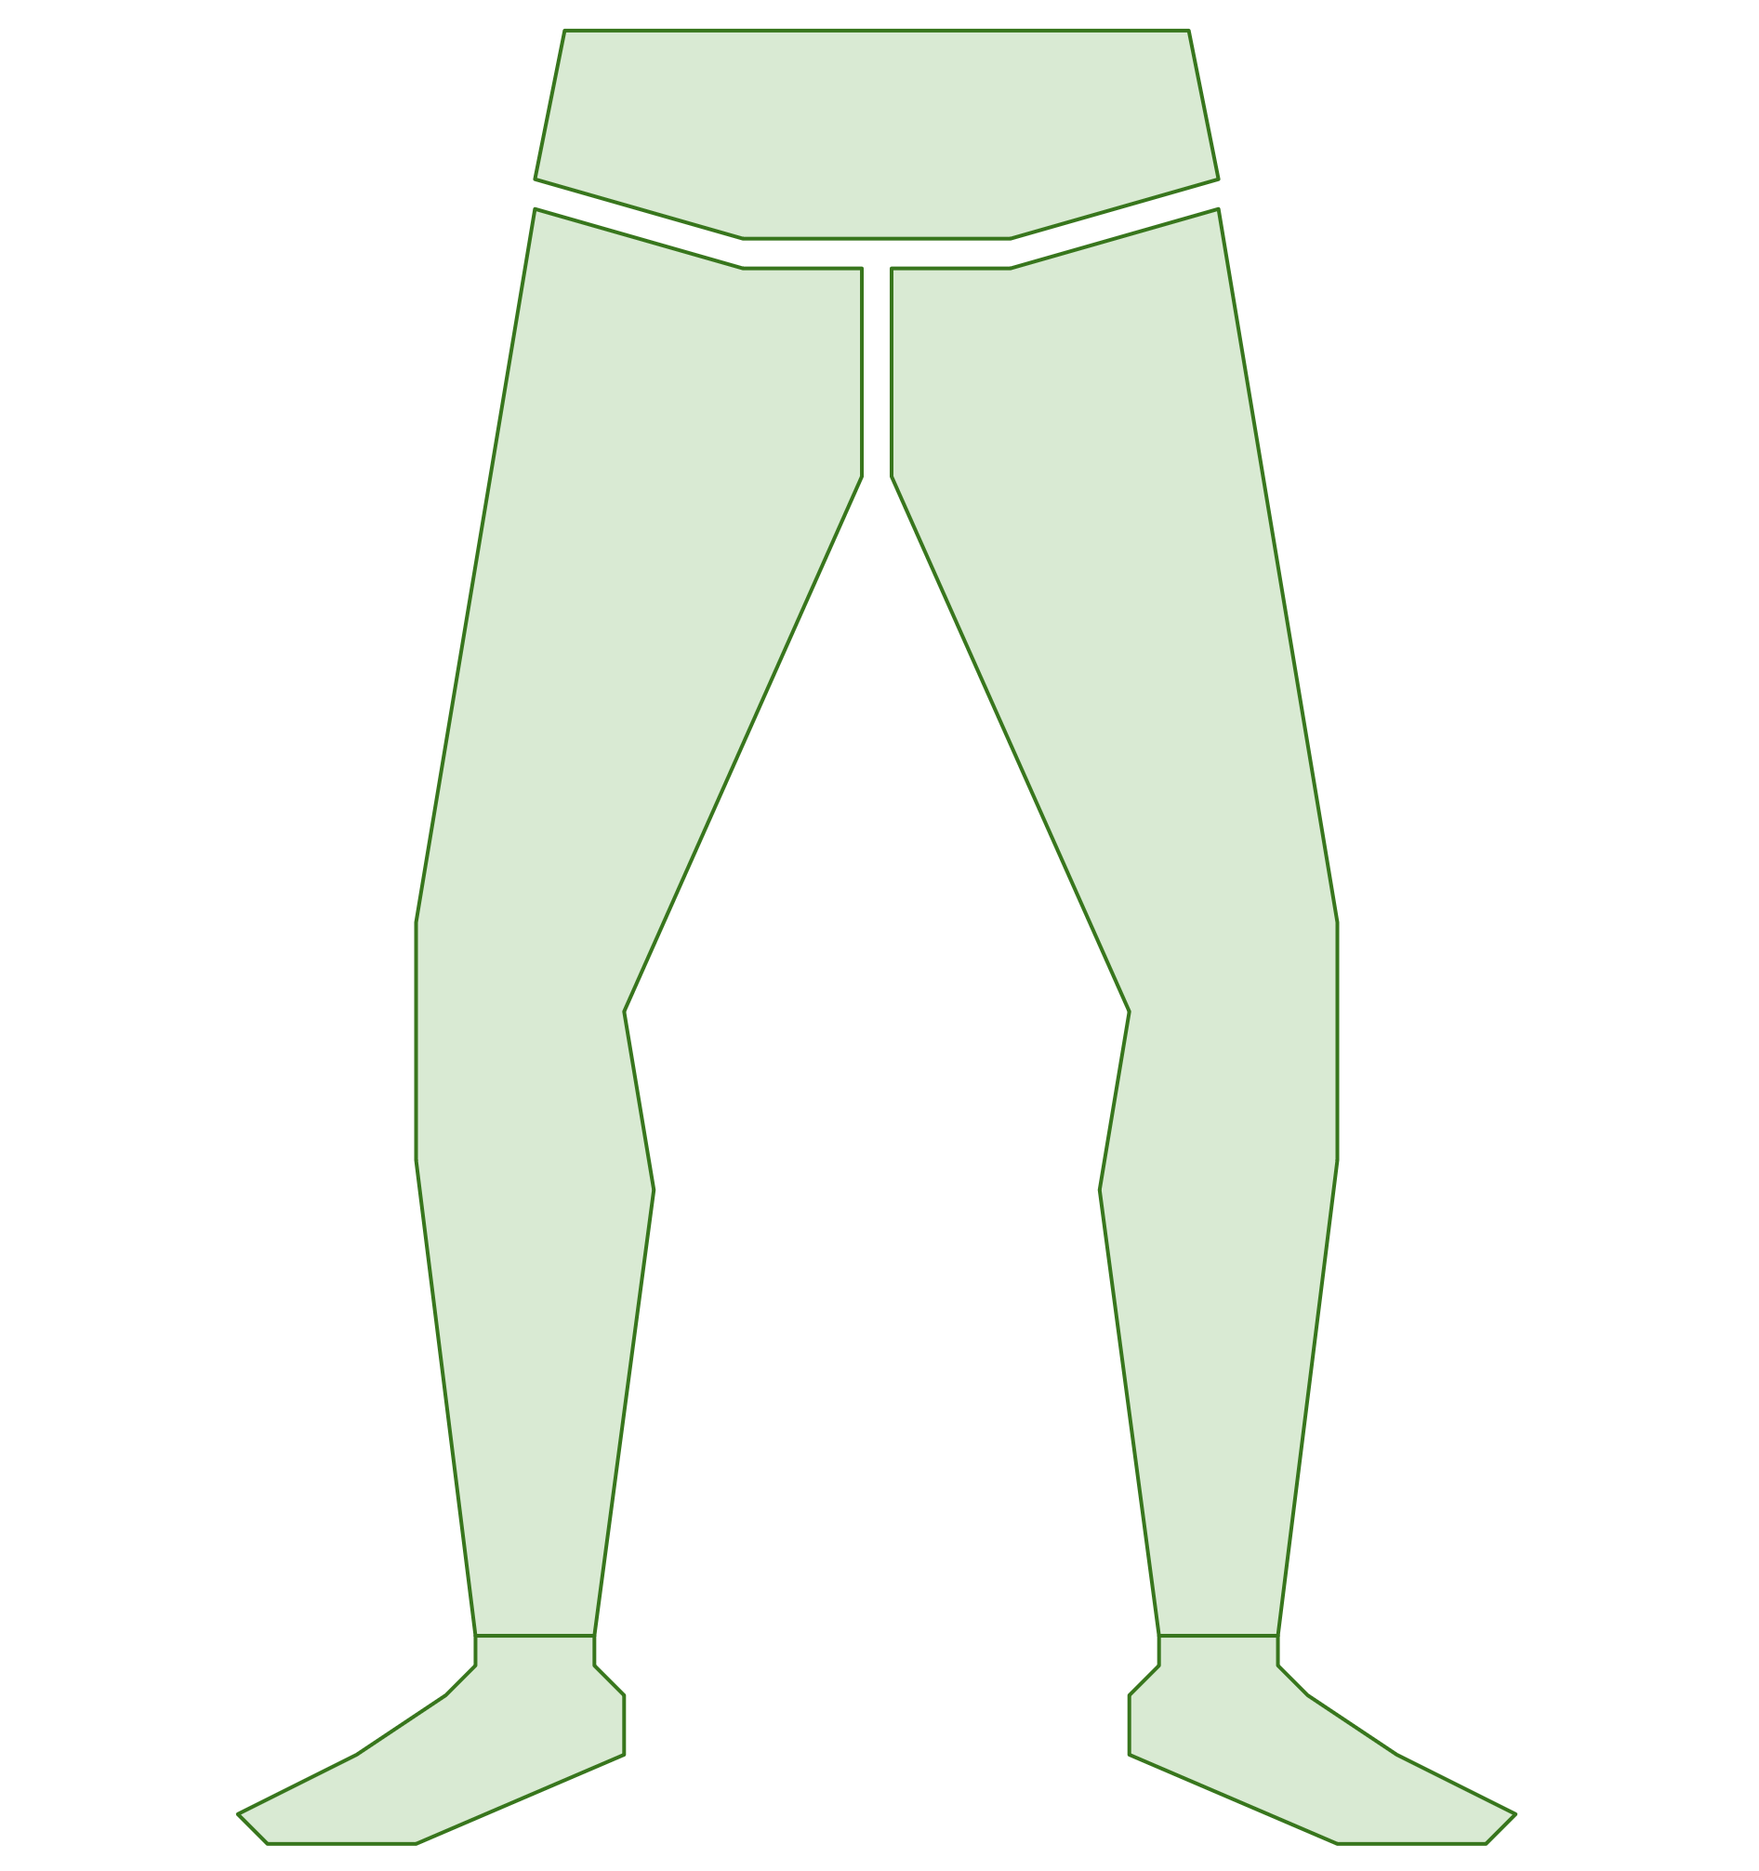
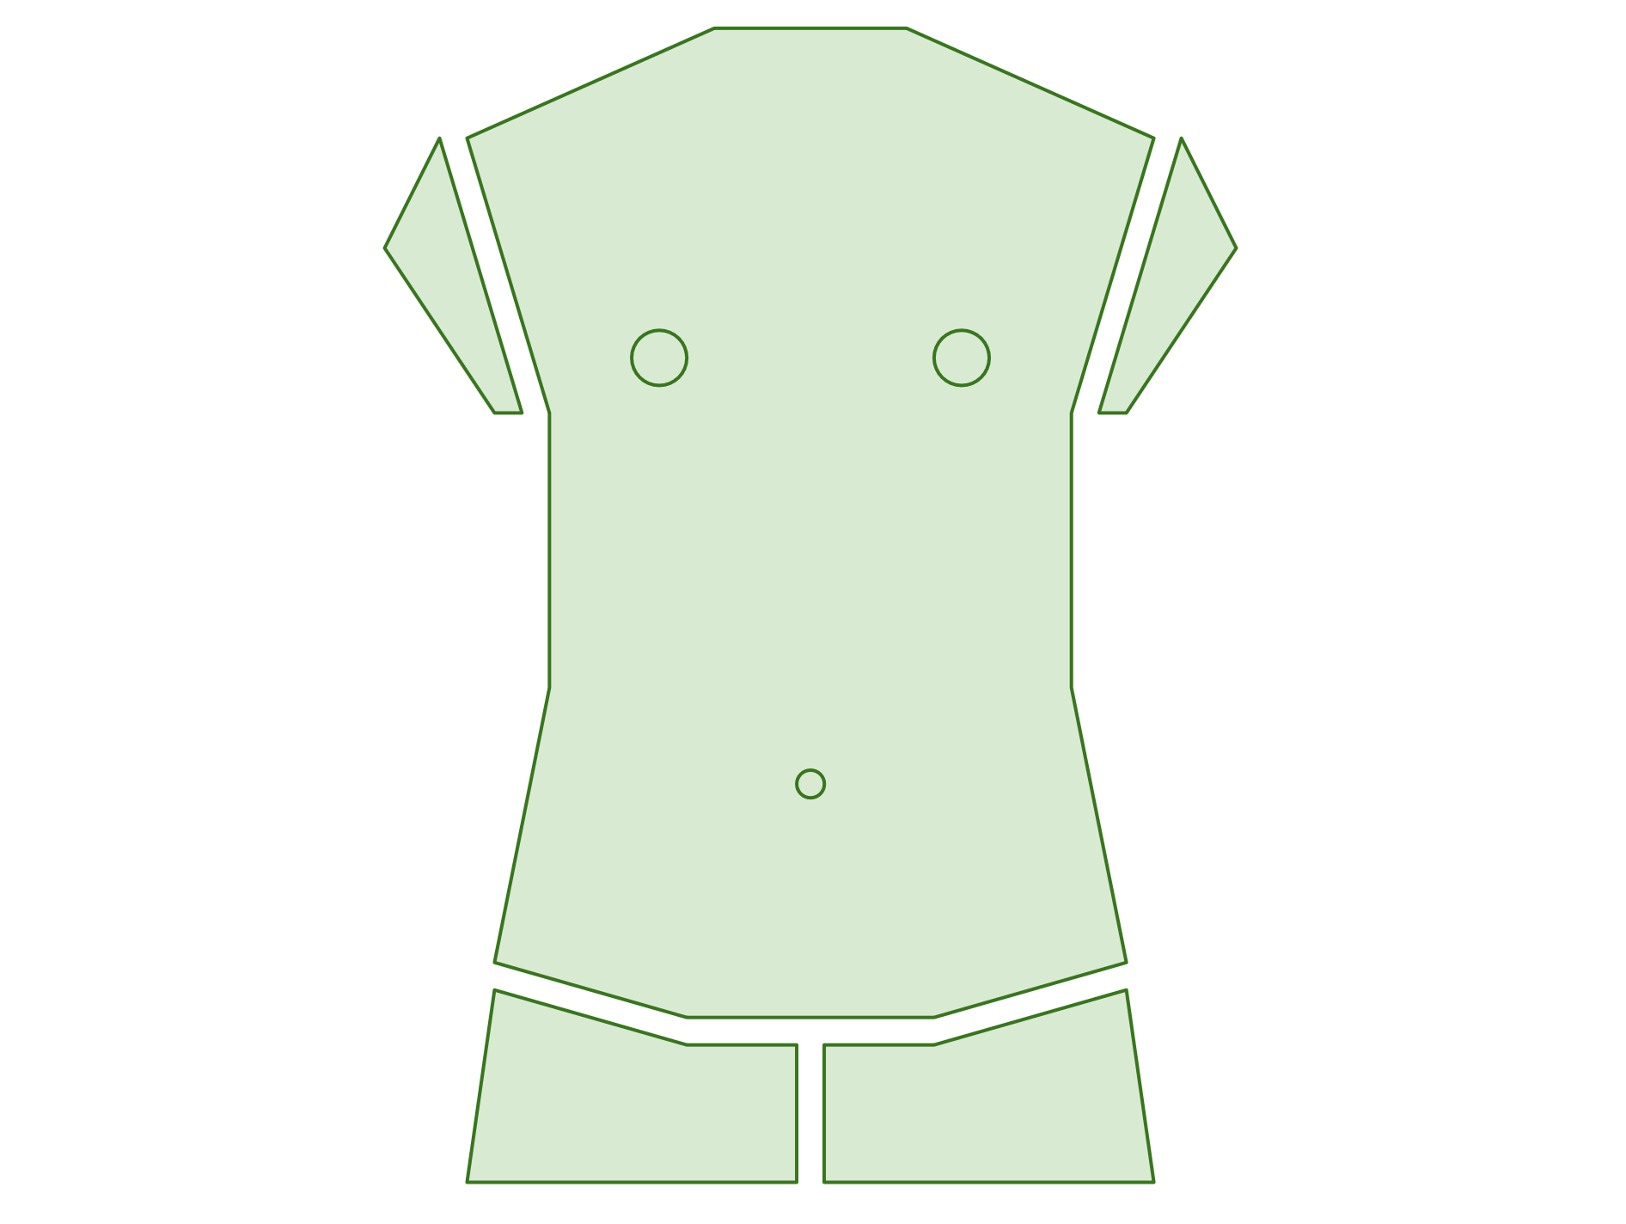
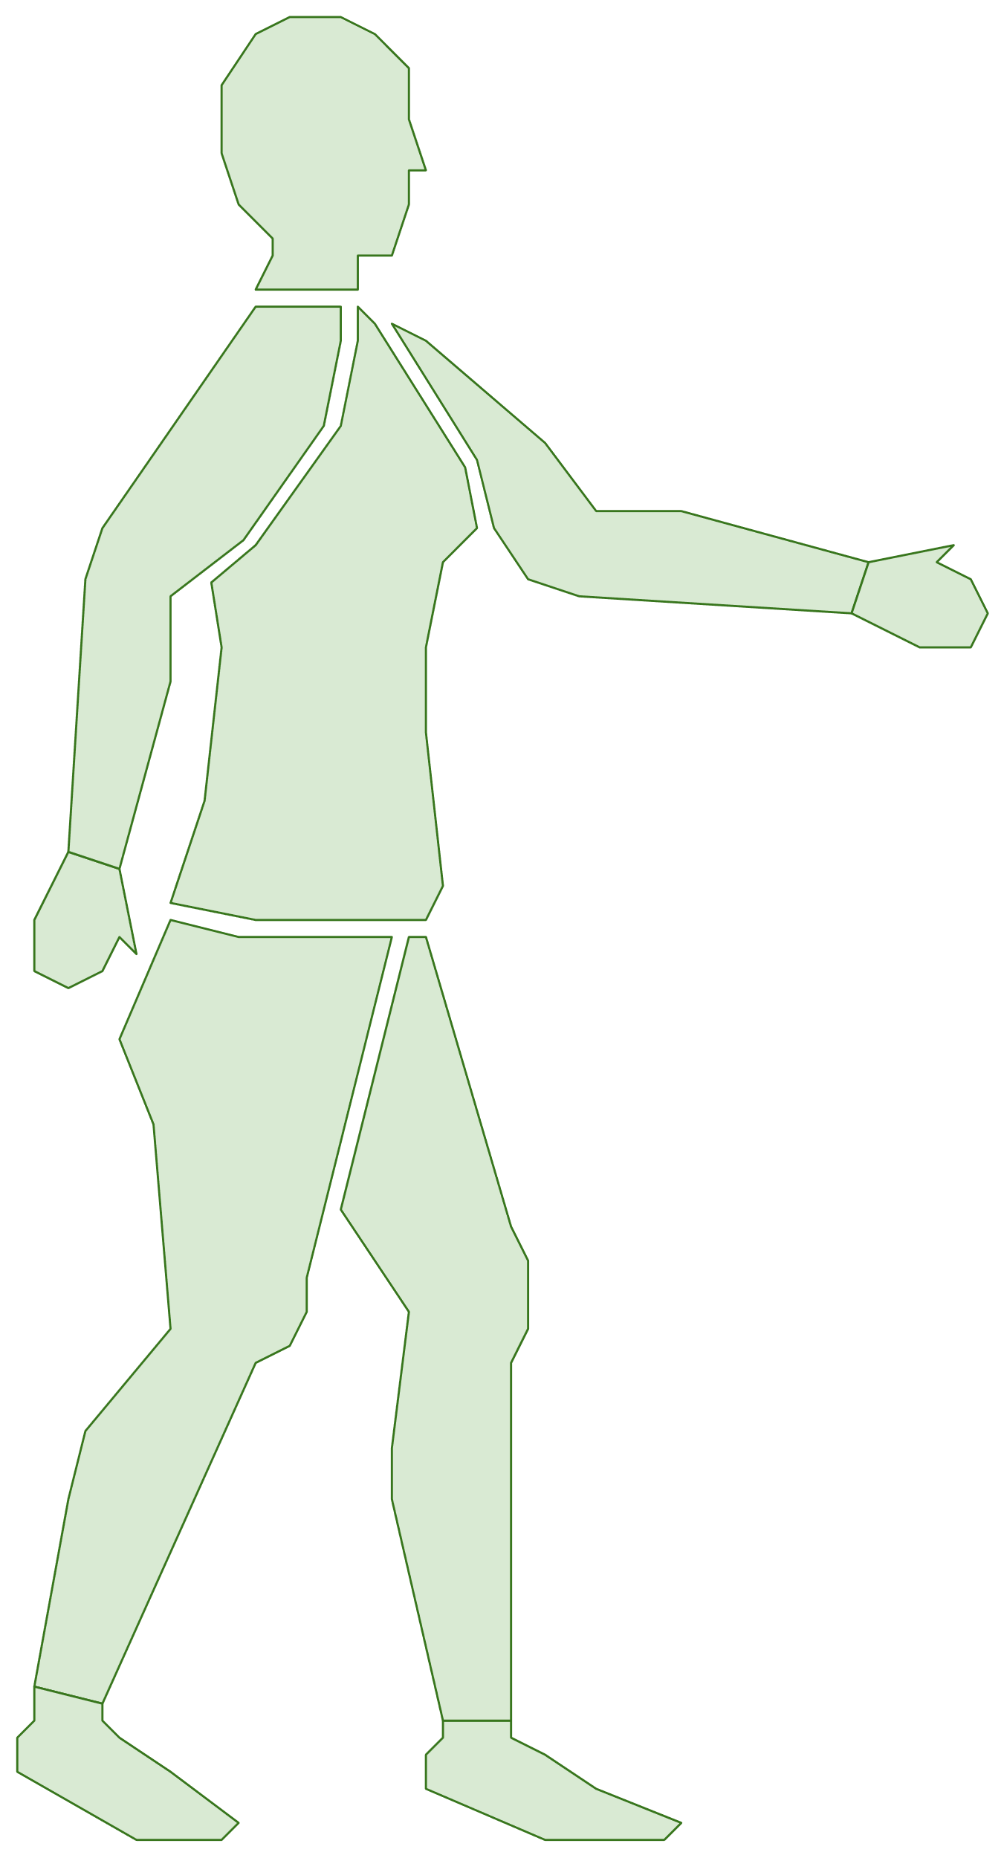
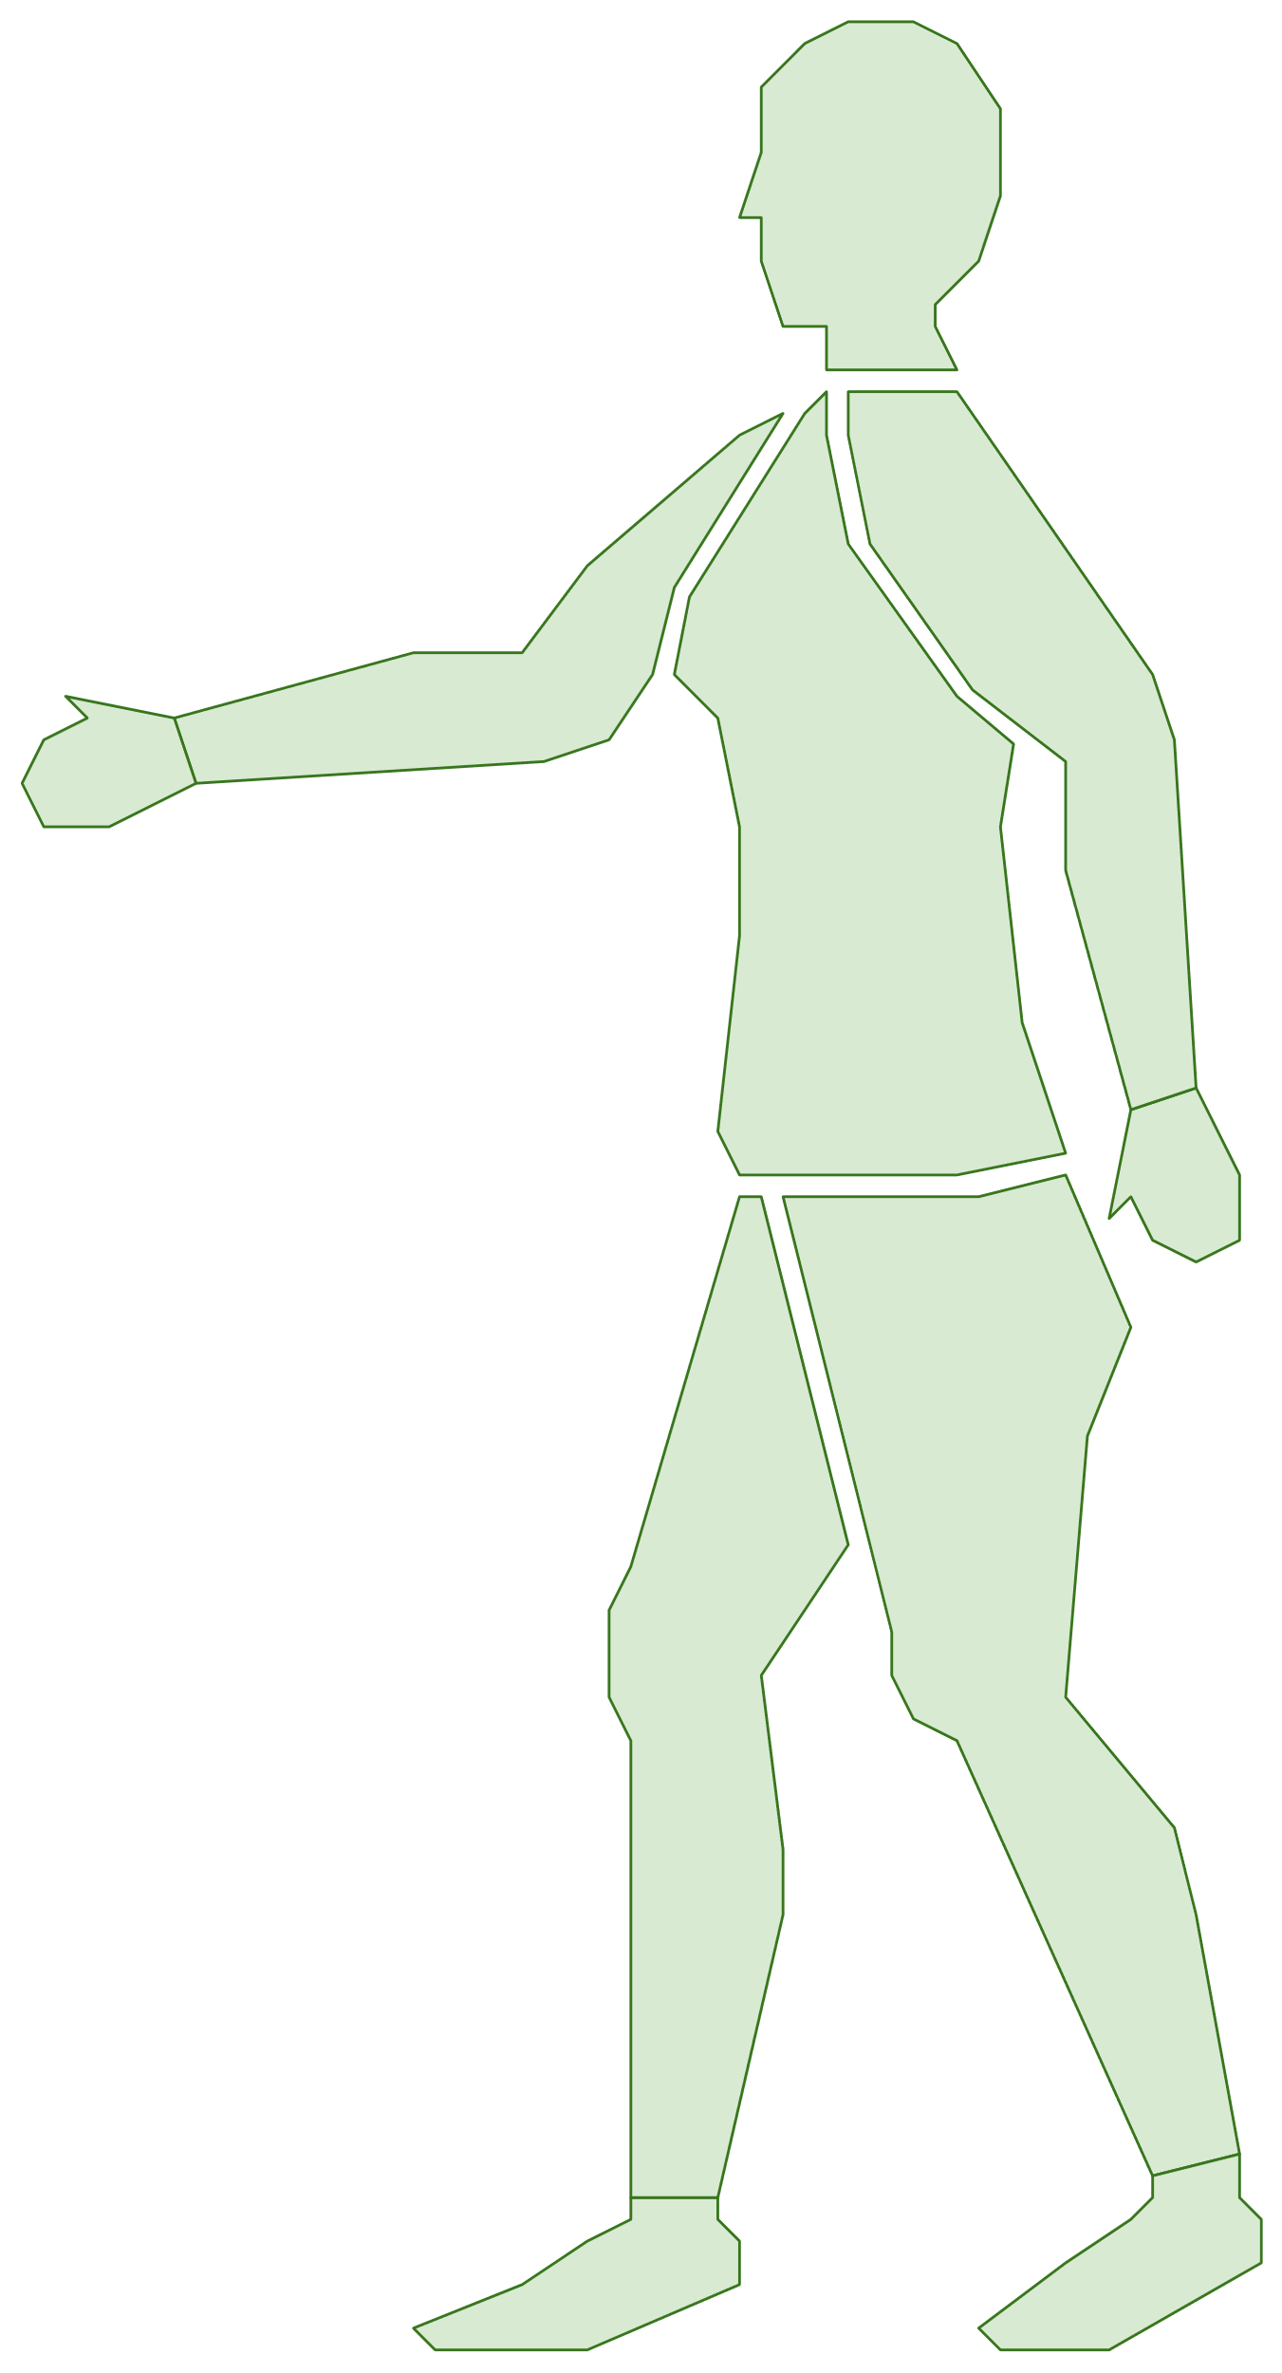

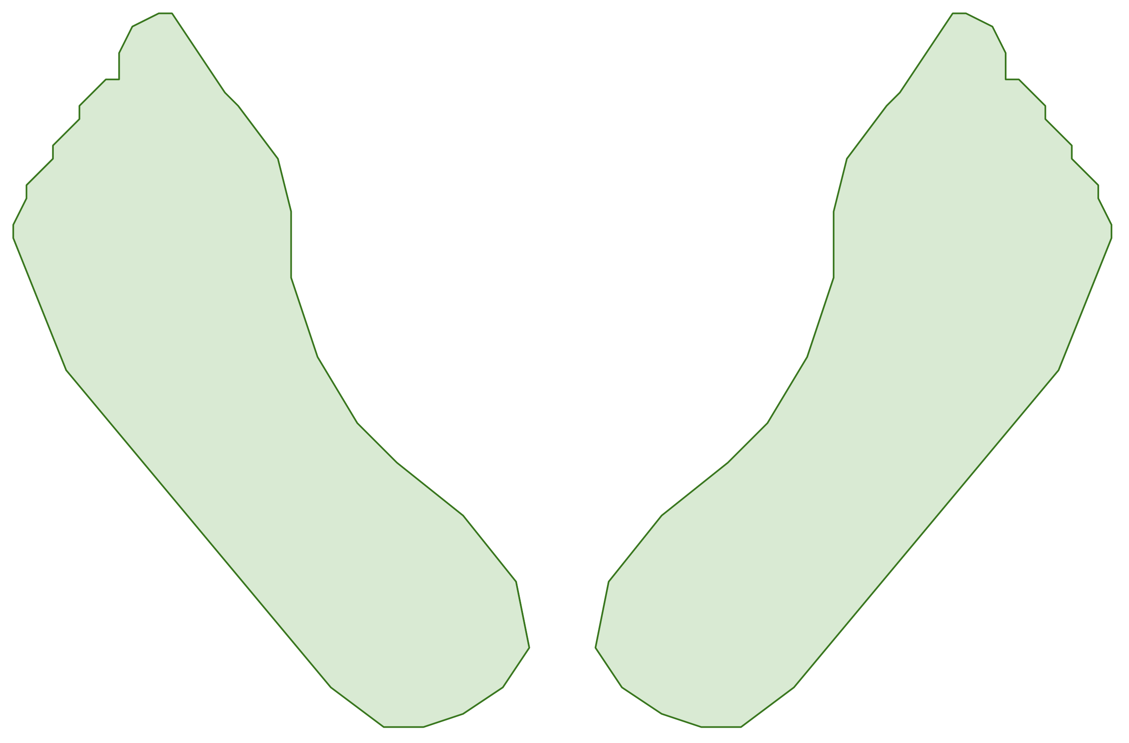
Skin imaging data
Standard clinical poses
Self taken poses

Slide 6
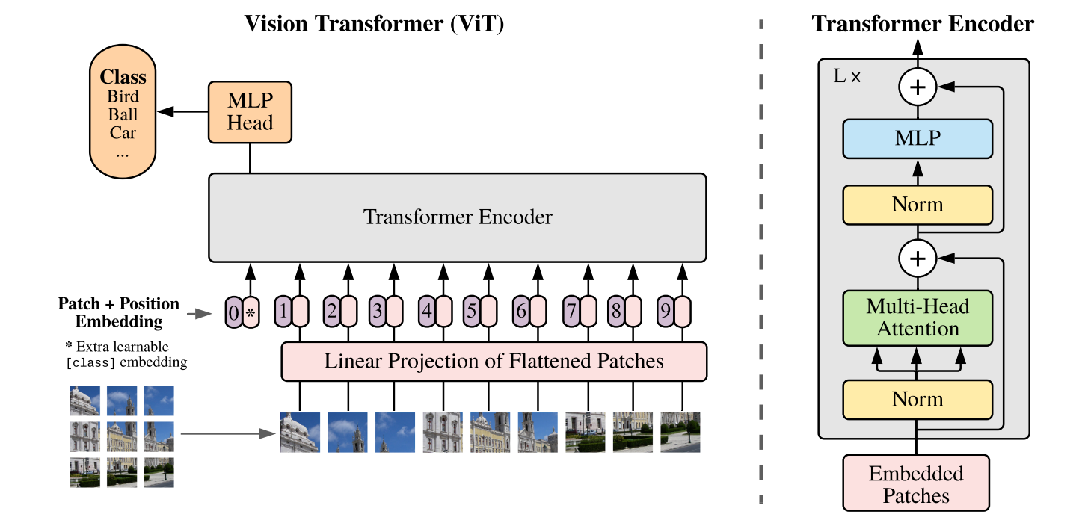
The Vision Transformer architecture
A Dosovitskiy et al., “An Image is Worth 16x16 Words: Transformers for Image Recognition at Scale”, ICLR 2021. Used under fair use for educational purposes

Slide 7
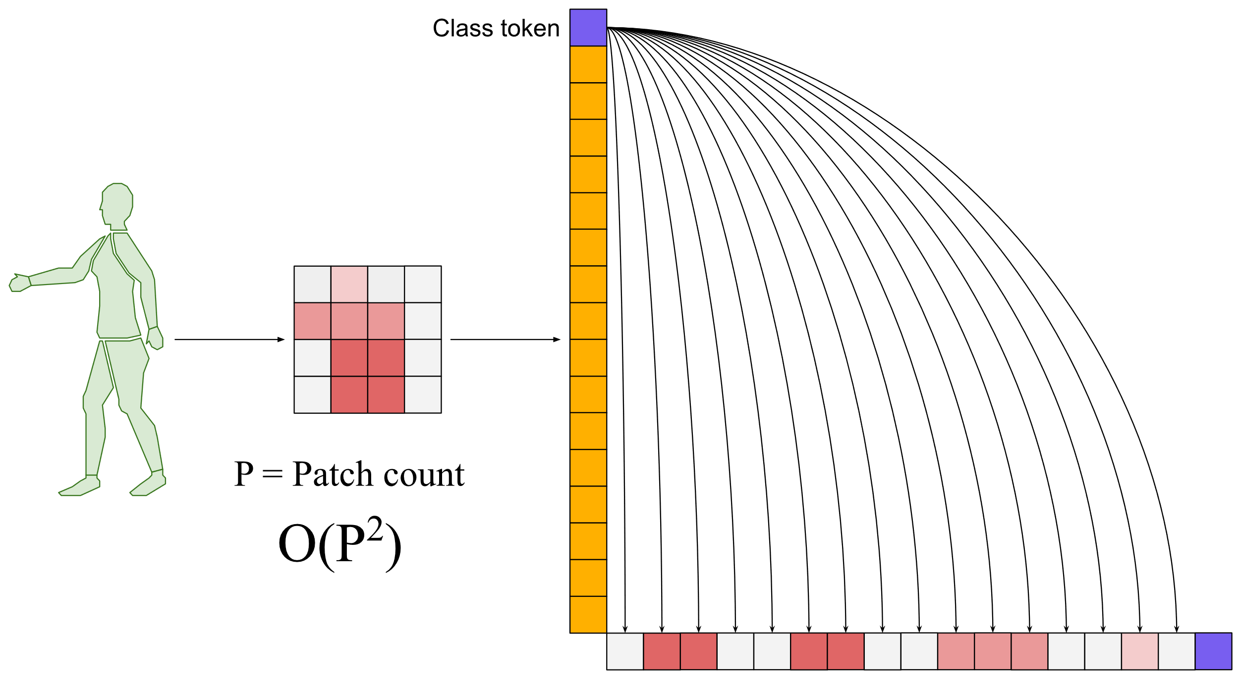
The attention mechanism

Slide 8
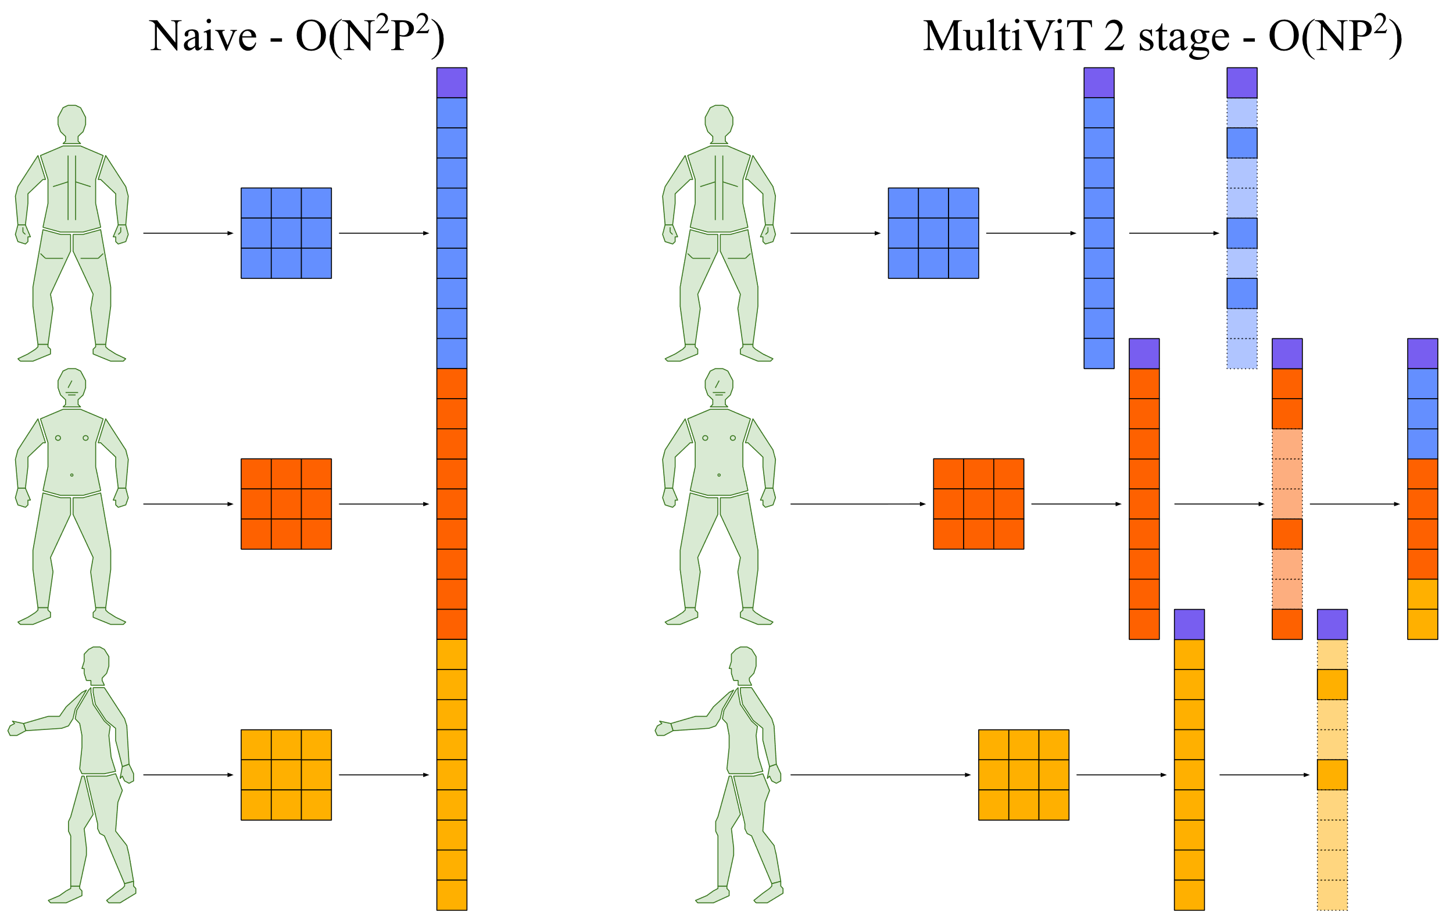
Attention across images

Slide 9
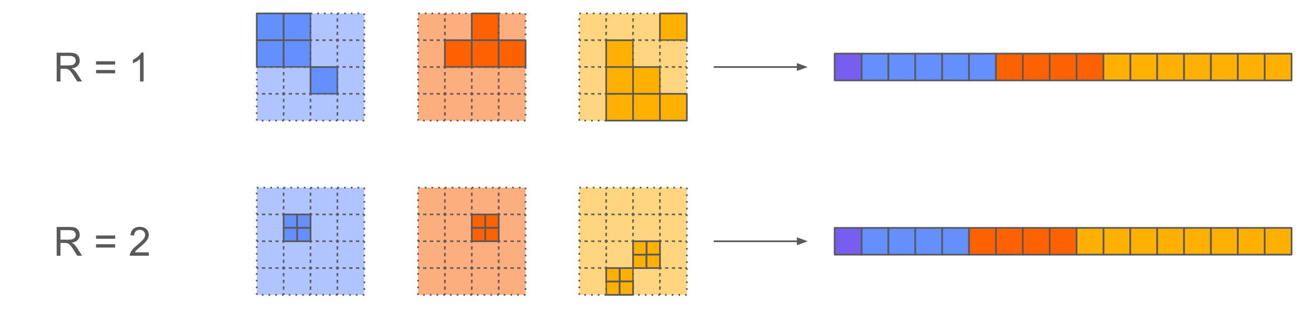
Fine-grained attention
Psioriasis photos are high resolution (e.g., 1000s x 1000s)
Vision Transformers take low resolution (e.g., 384 x 384)
Optionally zoom into selected patches by factor of R

Slide 10
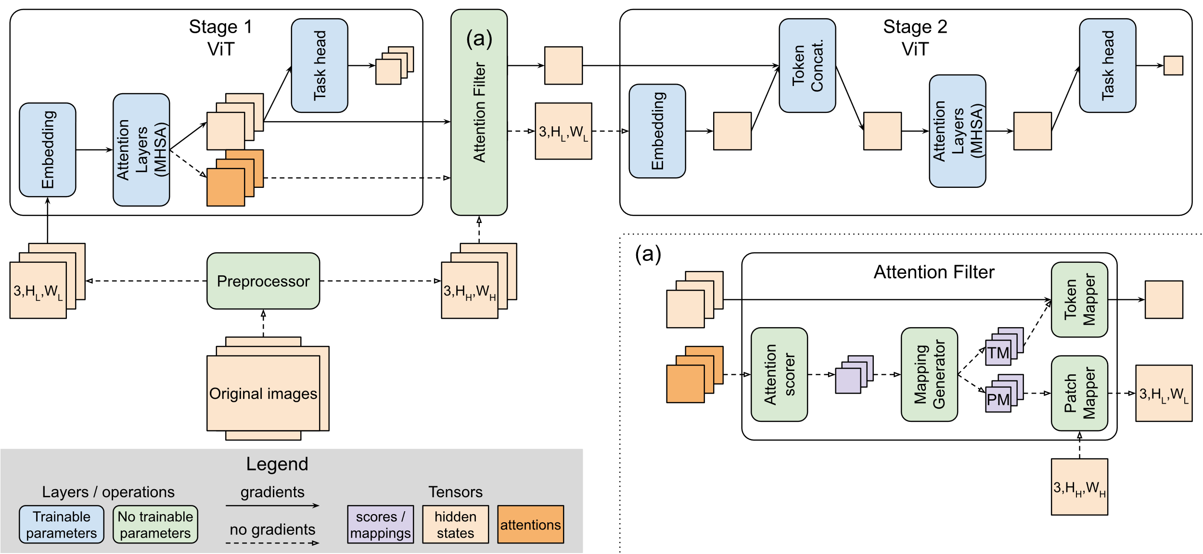
The MultiViT Architecture
Configurations
Multi / Partial: Whether tokens are passed from stage 1 to stage 2
N: The number of images
R: The resolution multiplier to apply to stage 2 patches

Slide 11
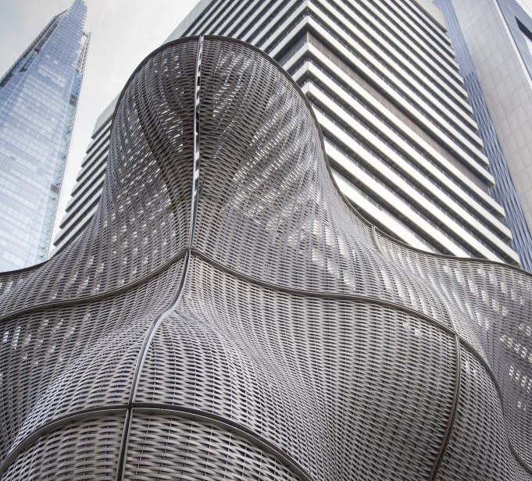
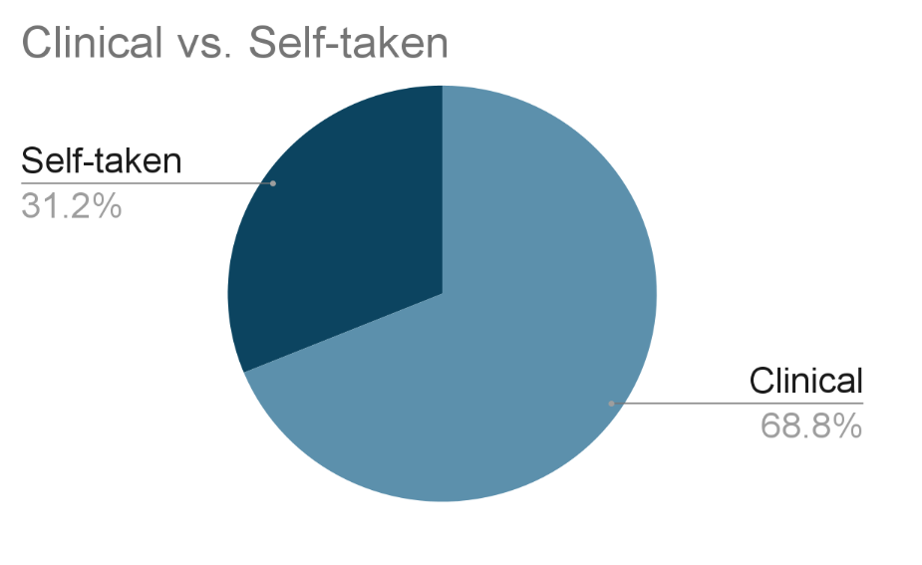
Dataset
Dataset:
Collected by St. John's Institute of Dermatology, Guy's and St. Thomas NHS Trust
Shared with us under ethics agreement
1109 colour images from 152 patients
763 clinical poses
346 self-taken images
Image widths: 480 – 6016 pixels
Image heights: 480 – 4640 pixels

Slide 12
Results
Key observations
Potential for clinical suitability
Inter-rater MAE for PASI is 4.67^{[1]}
Multi-3-1 is significantly within this threshold
All models under-predict
Multi-3-2 minimizes this effect
“Multi” vs. “Partial”
Similarly-sized models
Suggests token passing is effective
Resolution enhancement
Not effective in terms of MAE
Less tendency to under-predict
Configuration | MAE | ME
Simple | 5.127 | -3.192
Multi-3-1 | 3.877 | -2.402
Multi-3-2 | 4.220 | -1.741
Partial-3-1 | 4.674 | -2.644
Partial-3-2 | 4.516 | -2.721
[1] Huang et al., Artificial Intelligence-Based Psoriasis Severity Assessment: Real-world Study and Application, Journal of Medical Internet Research, 2023; 25

Slide 13
Stratification
Fitzpatrick skin type
Physician Global Assessment Severity
Configuration | MAE I-IV | MAE V-VI | ME I-IV | ME V-VI
Simple | 3.968 | 9.763 | 0.179 | -12.462
Multi-3-1 | 2.804 | 8.167 | -1.178 | -7.298
Multi-3-2 | 2.736 | 10.158 | 0.117 | -9.171
Partial-3-1 | 3.402 | 9.761 | -0.009 | -9.891
Partial-3-2 | 4.283 | 5.451 | -2.080 | -5.281
Configuration | MAE 0-3 | MAE 4-5 | ME 0-3 | ME 4-5
Simple | 2.460 | 12.462 | 0.179 | -12.462
Multi-3-1 | 1.967 | 9.128 | -0.225 | -8.387
Multi-3-2 | 2.328 | 9.425 | 0.995 | -9.155
Partial-3-1 | 2.464 | 10.752 | -0.008 | -9.891
Partial-3-2 | 2.727 | 9.436 | -0.279 | -9.437

Slide 14
Limitations / Next steps
Limitations
Proof of concept
Insufficient data
High heterogeneity
Poor coverage of challenging skin types
New, much larger dataset on the way
Needs more detailed analysis
Need more insight
Adapting to self-taken images from clinical
Network
Patch distortion for high / low aspect ratios
Limited attention scoring
Not using full power of ViT models
Position ambiguity for corresponding patches across multiple images
Next steps
More data
Pre-training on large unlabeled psoriasis dataset
Test on another imaging task (N can be 1)
General adaptive attention
Test on high-res single image dataset
Method improvements
Patching
Attention scoring / patch selection
Multi-pass inference
Part-based scoring
Early deployment
Trialing via MySkin with clinical eval

Slide 15
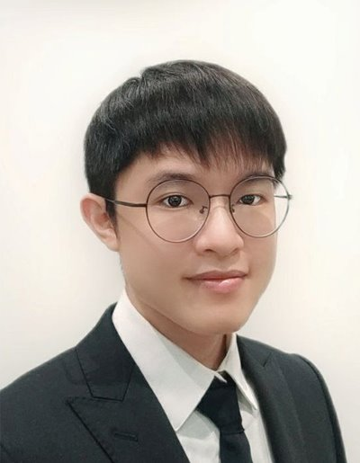
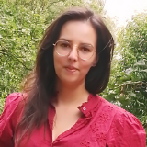

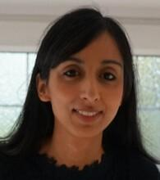
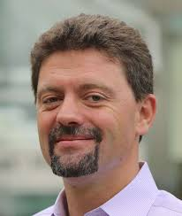
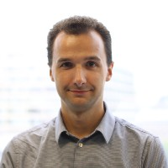

Thank you! Questions.
Co-authors
benjamin.murray@kcl.ac.uk
https://github.com/KCL-BMEIS/MultiViT
MySkin Team

